Slide 1

Shipment Pricing Prediction
Project By: Shivanand Satyappa Nashi
Technologies: Machine Learning Technology
Domain: Supply Chain Management

Slide 2
Objective:
Accurate Pricing Prediction: Develop a machine learning model to predict shipment pricing based on relevant features.
Understand Key Drivers: Identify and analyze the most significant factors affecting shipment costs (e.g., weight, distance, delivery time, etc.).
Cost Optimization: Assist logistics companies in optimizing their pricing strategies to improve profitability.
Customer Satisfaction: Enable transparent and fair pricing for customers by predicting costs accurately.
Operational Efficiency: Help streamline shipment operations by forecasting costs and planning resources effectively.
Competitive Advantage: Provide insights for competitive pricing in the logistics market.

Slide 3
Benefits:
1.Improved Pricing Accuracy:
Ensures shipment prices are competitive and reflective of actual costs.
2.Cost Efficiency:
Reduces overpricing or underpricing risks, enhancing profit margins.
3.Enhanced Decision-Making:
Provides actionable insights for strategic pricing and operational adjustments.
4Customer Satisfaction:
Transparent and fair pricing builds trust and loyalty among customers.
5 Resource Optimization:
Enables better allocation of resources, such as transportation modes and routes, based on pricing forecasts.
6.Market Competitiveness:
Helps logistics companies stay ahead in the market with data-driven pricing strategies.

Slide 4
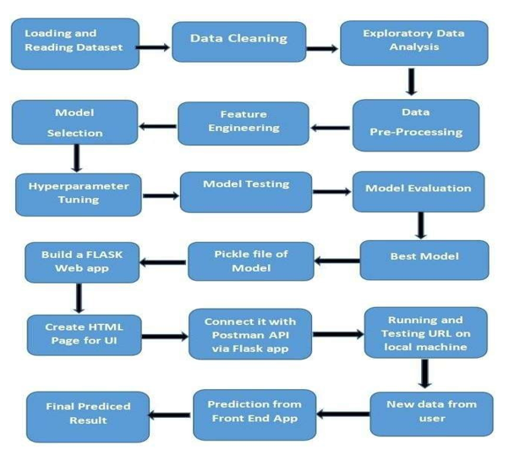
Architecture:

Slide 5
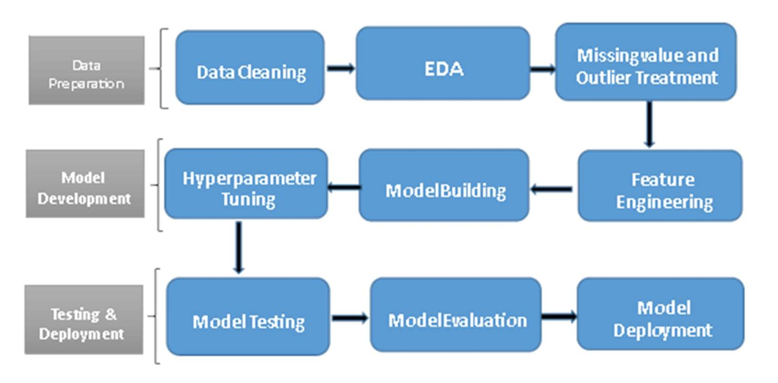
Process Flow:

Slide 6
Data Validation:
Missing Values Check: Identify and handle missing or null values in the dataset.
Duplicate Data Check: Remove any duplicate entries to avoid bias in predictions.
Data Consistency: Validate data formats, such as weights in kilograms or pounds, distances in kilometers or miles, etc.
Outlier Detection: Identify and handle extreme values that may distort predictions.
Data Type Validation: Confirm that columns have the correct data types (e.g., numeric for weight, categorical for shipment mode).
Range Validation: Ensure all values fall within logical and expected ranges (e.g., shipment distance cannot be negative).

Slide 7
Data Transformation:
1.Normalization/Standardization:
Scale numerical features (e.g., weight, dimensions, distance) to ensure all variables contribute equally to the model.
2. Encoding: Convert categorical variables (e.g., shipment mode) into numerical format using one-hot or label encoding.
3.Feature Engineering: Create new features (e.g., cost per kilometer) to enhance predictive power.
4. Handling Missing Values: Impute missing data using mean, median, or mode.
5. Log Transformation: Apply to skewed data to stabilize variance and improve model performance.
6. Date/Time Processing: Extract meaningful features like delivery duration or holiday impact.
7. Dimensionality Reduction: Remove irrelevant or redundant features to simplify the dataset.

Slide 8
Model Training:
Export Data :
The accumulated data is exported to python and read using pandas.
Data Preprocessing:
Performing EDA to get insight of data like identifying distribution ,outliers treatment, trend among data etc.
Check for null values in the columns. If present impute the null values.
Encode the categorical values with numeric values.
Perform Standard Scalar to scale down the values.
Create New features in accordance with business domain helpful for model building process.

Slide 9
Model Selection:
Different Regression models were compared and hyperparameter tuning was done via grid research on the best performing one that is Light-gbm Regressor.
Prediction:
The model is made in such a way to maximise the results and also other performance metrics so that the predictions are as accurate as possible
The training R-square for our model is 0.998273 and test R-square is 0.991598.
Features such are ‘Days to Process', 'Line Item Insurance', 'Shipment Mode’, ‘Freight Cost’ are of importance.

Slide 10
Q & A
Q1) What’s the source of data?
The main source is Kaggle and for the prediction the data for training is provided by the client in the form answers to certain questions asked which the user has to input.
Q 2) What was the type of data?
The data was the combination of numerical and Categorical values.
Q 3) What’s the complete flow you followed in this Project?
Refer slide number 4 and 5 for better understanding
Q 4) What techniques were you using for data pre-processing?
▶ Removing unwanted attributes
▶ Visualizing relation of independent variables with each other and output variables
▶ Checking and changing Distribution of continuous values
▶ Outliers Treatment
▶ Cleaning data and imputing if null values are present.
▶ Converting categorical data into numeric values.
▶ Scaling the data

Slide 11
Q 5) How training was done or what models were used?
Before training the model the dataset is divided into the training set and testing set.
▶ The scaling was performed on the training and testing set.
▶ The categorical columns were converted into numeric values.
▶ We train the different models using a training set by using multiple regression algorithms like Linear Regression, CART, Random Forest, ANN, XGBoost, and Grid Search CV for best parameters.
▶ Then we test each model with a test set, we will find the accuracy of train and test predictions using evaluation metrics like RMSE (Root mean squared error) and r2_score (R-squared).
▶ The model which gives close train and test accuracy with the least RMSE train test
▶ First, we started with data cleaning, EDA and feature engineering
▶transformation was applied for categorical columns like one hot encoding, label encoding, etc. Then, outliers and ambiguities were removed from the data and categorical features data

Slide 12
Q 6) How Prediction was done?
Some questions were asked to the client like Shipment Mode, Manufacturing Site, Unit Price etc and the responses are taken as inputs which are then feeded to the model as a single test case and the predictions are then returned on the clients screen after a interval of two seconds in which the model processes the input data to get the output
7) What are the different stages of deployment?
To deploy a model, we used the following steps:
1.Save the trained model as a pickle file using Python's pickle library.
2.Create a Flask app in Python, which will act as the server for your model.
3.Define the routes for the Flask app, which will determine the behavior of the server when it receives different HTTP requests.
4.In the routes, we loaded the pickle file and use it to make predictions based on the input received in the request.
5.We created HTML templates to display the results of the predictions on a website.
6.Test the Flask app using Postman or a similar API testing tool to ensure it is working correctly. after a interval of two seconds in which the model processes the input data to get the output.

Slide 13
Thank You!....

